Slide 1
Edwards: Why the big secret? People are smart. They can handle it. K: A person is smart. People are dumb, panicky dangerous animals and you know it. Fifteen hundred years ago everybody knew the Earth was the center of the universe. Five hundred years ago, everybody knew the Earth was flat, and fifteen minutes ago, you knew that humans were alone on this planet. Imagine what you'll know tomorrow. – Men in Black

Slide 2
Announcements
Blackboard Quiz #3 will come out today or tomorrow and will be due Sunday, Sept. 11, 11:59 pm.
It will cover the last 3 classes (including today) on protein structure and techniques for separation and identification.
Tomorrow, Michael Rossmann will discuss the structure of the Zika and other infectious viruses in MJIS 1001 at 1:30.

Slide 3
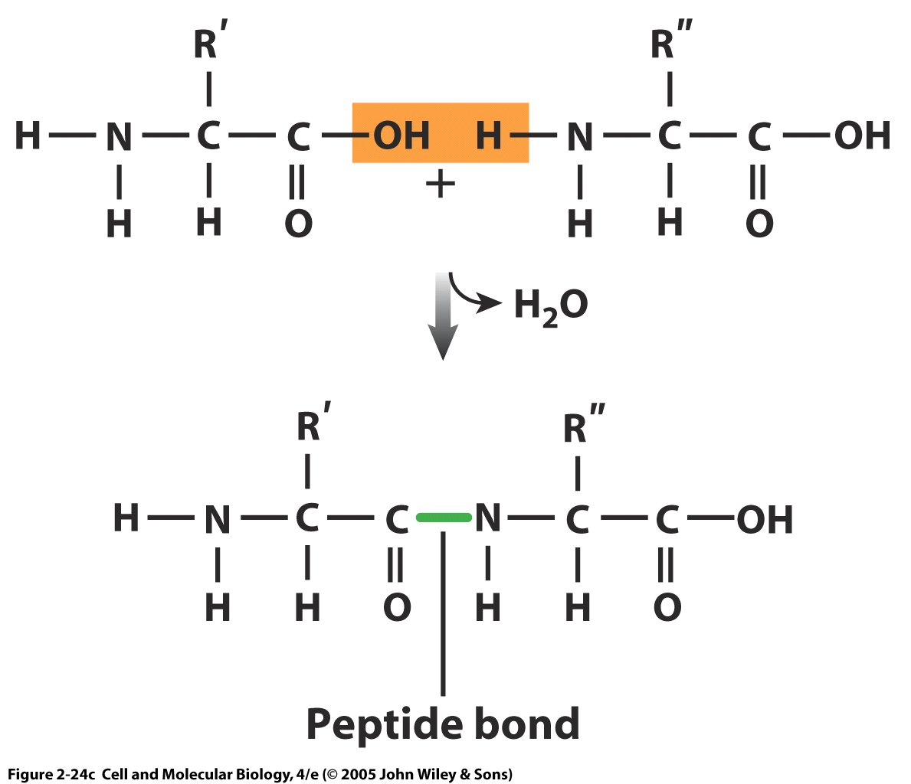
Amino acids are linked by covalent peptide bonds
amine
acid
Bonds are formed by condensation (dehydration) between the acid (carboxyl) end of one amino acid and the amino group of the other.
Loses a water in the process.
Notes:
1. Amino acid backbone is a-carbon between NH2 & COOH groups; all but one (glycine) have symmetric centers so there are 2 stereoisomers D- & L-amino acids; only L-form in proteins

Slide 4
Clicker question: What can be said about sequences of valine, leucine and isoleucine with hydrocarbon side chains?
They will associate with the extracellular space
They will associate with the intracellular space
They will associate with the extracellular and intracellular space (cytosol)
They will associate with the plasma membrane
None of the above
Notes:
Answer is D

Slide 5
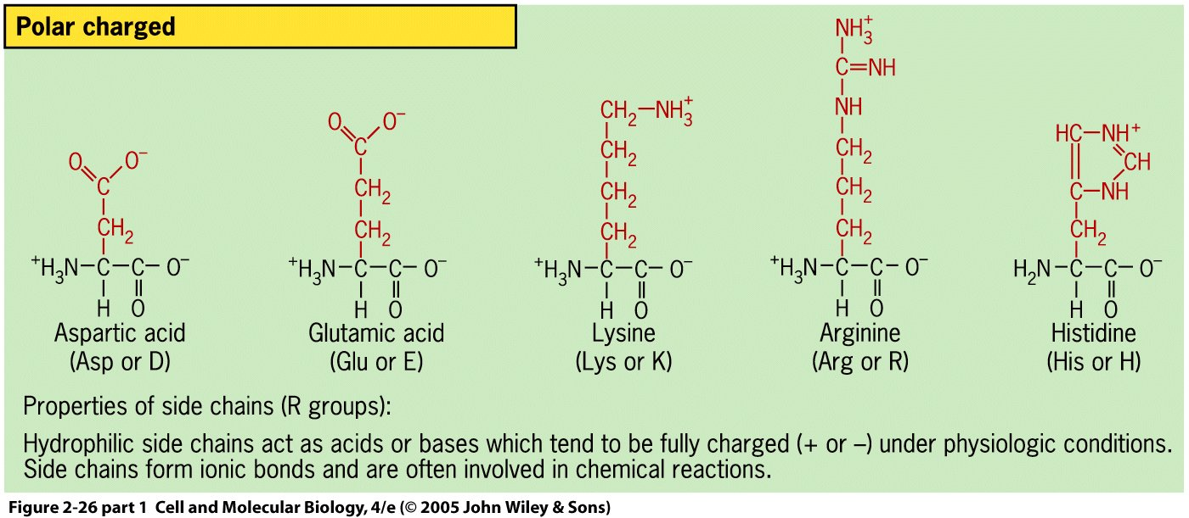
Polar charged side chains are charged, hydrophilic, and reactive at physiological pH (7.4)
Acid side chains have donated a proton, H⁺, so they are now negatively charged
Basic side chains have accepted a proton, H⁺, so they are now positively charged

Slide 6
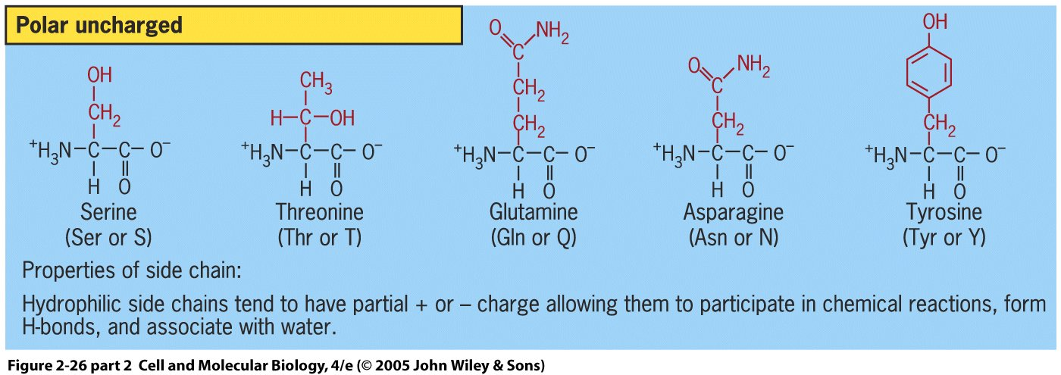
Polar uncharged side chains are partially charged, hydrophilic, and reactive at physiological pH (~ 7.4)
Glutamine and asparagine are similar to glutamic acid and aspartic acid, but the charged O- has been replaced by an uncharged NH2 amine.

Slide 7
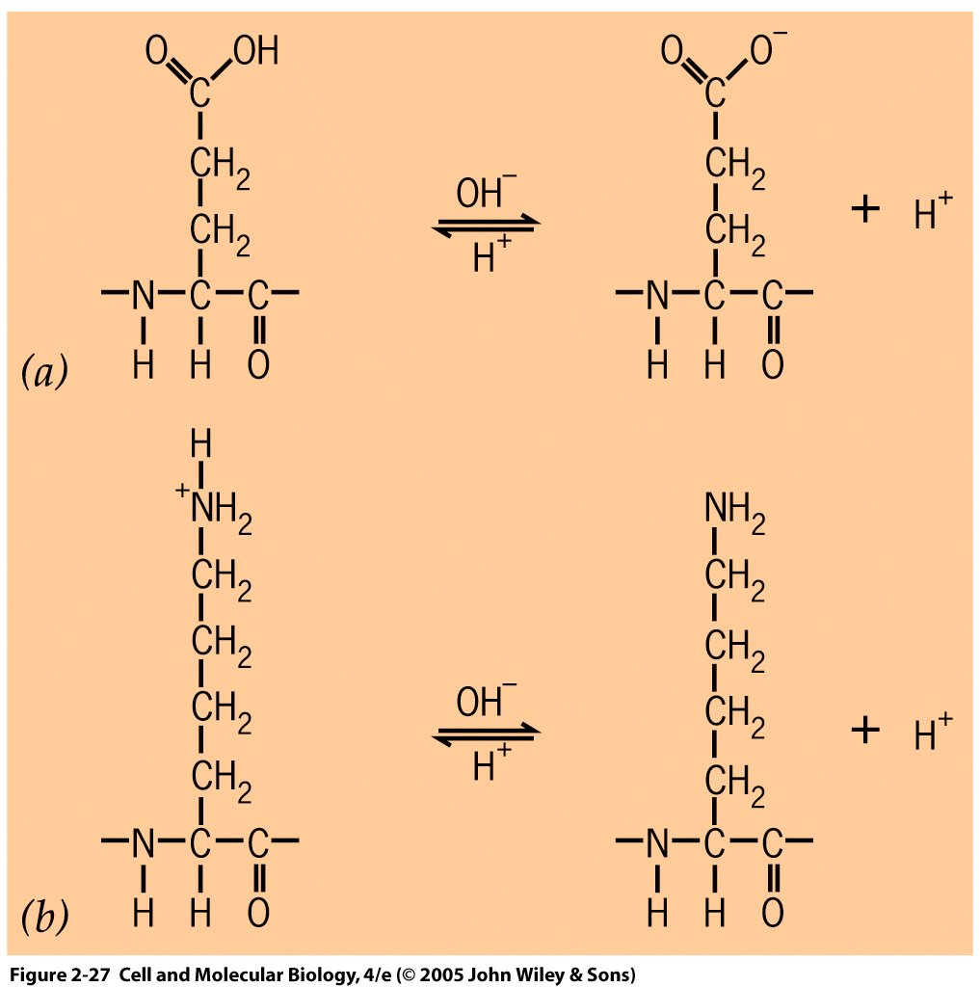
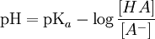
The acid dissociation constant pKa, determines the pH at which 50% of molecules have donated protons
Amino Acid Side Chain | pKa
Asp (D) | 3.8
Glu (E) | 4.3
Arg (R) | 12.0
Lys (K) | 10.5
Cys (C) | 8.28 (-SH)
Tyr (Y) | 10.1
+
(a): Glutamic acid (Glu)
(b): Lysine (Lys)
http://www.chemistry.mcmaster.ca/
Notes:
At pH 7.4,

Slide 8
Clicker question:
If a protein is brought into the lysosome (pH ~ 5) of a eukaryotic cell, how will the proportion of uncharged to charged Glu (pKa 4.3) side chains change?
[HA]/[A-] will increase
[HA]/[A-] will decrease
[HA]/[A-] will remain the same
None of the above
Notes:
The pka of the side chain of Glu is 4.3. If intracellular pH is ~7.3, then pH=pKa-log 10 ([HA]/[A-]) and log10 ([HA]/[A-]) =-3 after rearranging,
([HA]/[A-]) =.001, only .1% HA. At pH=5, log 10 ([HA]/[A-]) =-.7, which is approximately 1/5 or 0.2. So, ([HA]/[A-]) increased and there are more uncharged Glu side chains

Slide 9
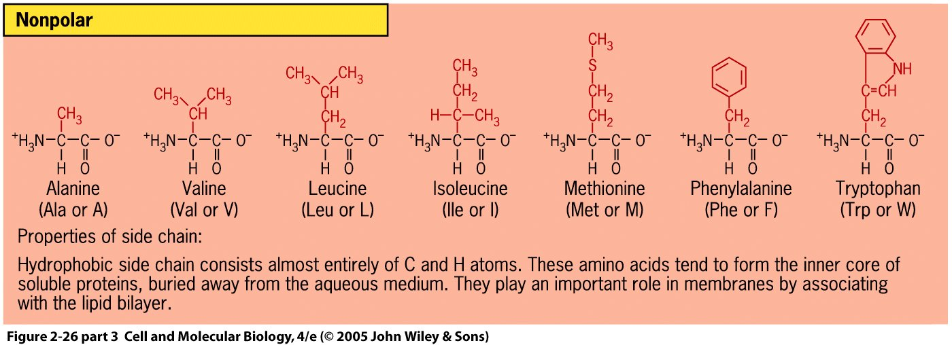
Nonpolar side chains are uncharged, hydrophobic, and weakly reactive at physiological pH

Slide 10
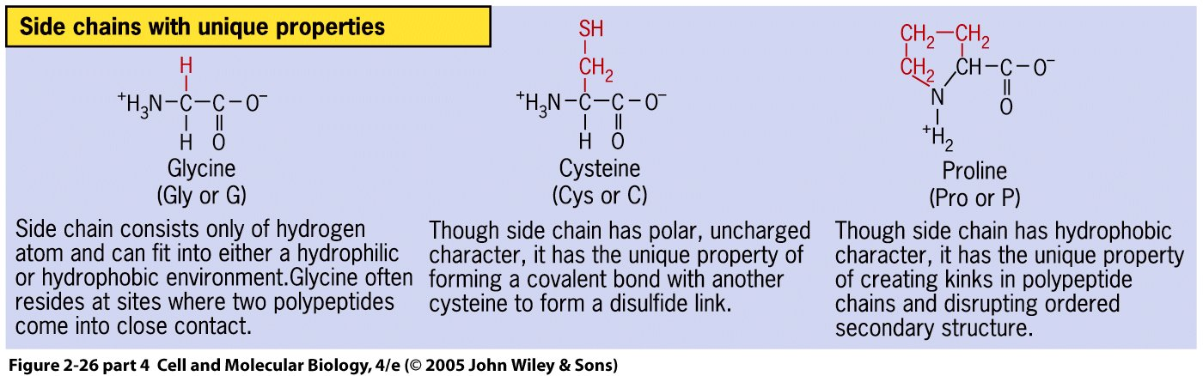
These nonpolar side chains have additional interesting properties.
Glycine: Can be in hydrophobic or hydrophilic environment. Short side chain length allows close contact with other peptides
Cysteine: The sulfur on the end can react with another cysteine to form a covalent disulfide bond that is often used to structurally stabilize proteins.
Proline: This side chain conformation promotes “kinks” in protein structure due to ringed side chain. Often occurs as a transition between different protein sections.
Notes:
The disulfide bridges often occur between sections separated by many amino acids. The proline ringed structure is an imino acid.

Slide 11
Clicker question: What do alpha helices and beta sheets have in common?
They are stabilized mainly by ionic bonds
They are stabilized mainly by van der Waals forces
They are stabilized mainly by hydrophobic interactions that minimize solvent entropy
None of the above
Notes:
Answer is D. They are stabilized by hydrogen bonds.

Slide 12
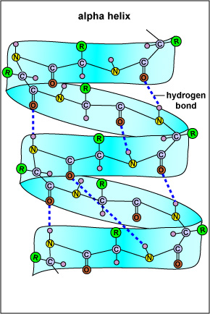
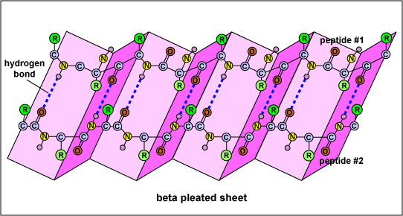
Both secondary structures are stabilized by hydrogen bonds between the carbonyl oxygen and the amine hydrogen.
http://faculty.ccbcmd.edu/~gkaiser/

Slide 13
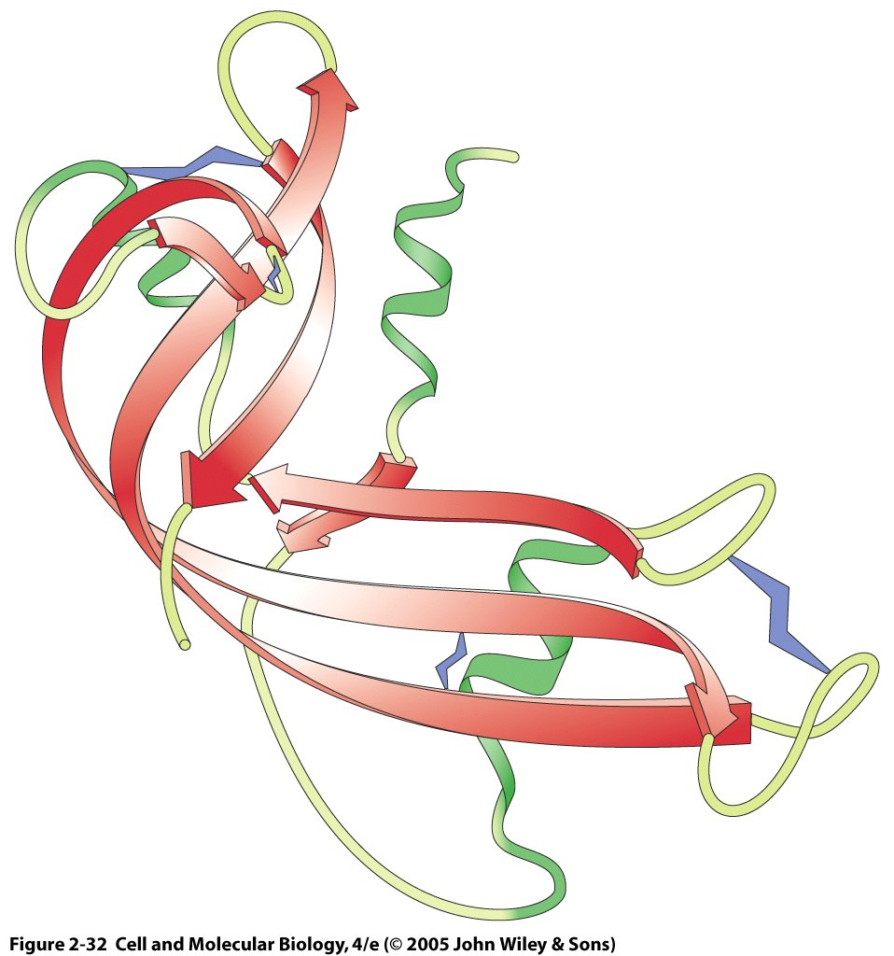
Schematic depiction of secondary structures showing tertiary structure of ribonuclease
Alpha helix (green)
Cysteine disulfide bond
Irregular structure,
Loops and turns
Beta sheet (red)
Irregular regions often sites of greatest biologic activity, Most flexible regions
Notes:
13
Irregular regions often sites of greatest biologic activity, Most flexible regions

Slide 14
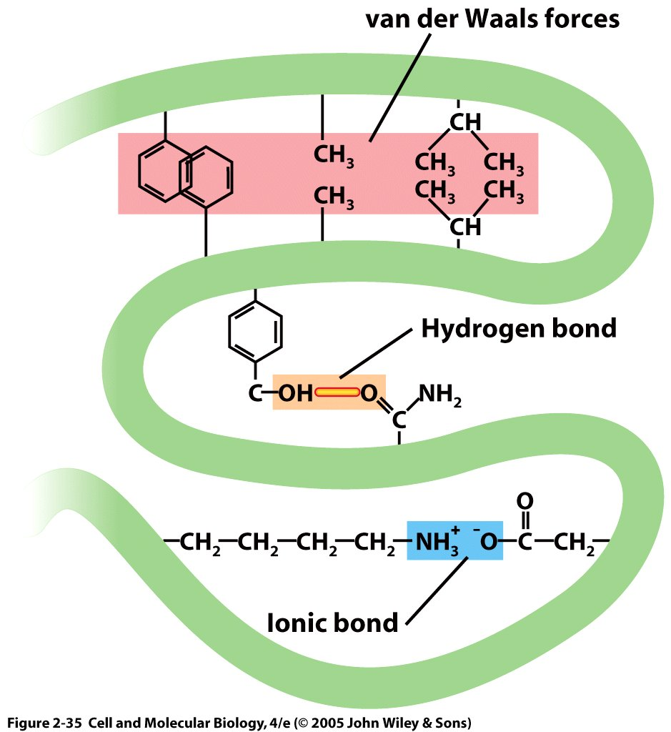
Noncovalent bonds are critical for the formation of protein secondary and tertiary structures from a given amino acid chain (primary structure)

Slide 15
All molecular structures are Gibbs free energy minimizers Protein structures are studied in this manner
Given some starting configuration of a structure, want to minimize G (make ΔG as negative as possible)
Changes in potential energy result from electrostatic interactions (covalent, hydrogen bonds, van der Waals)
“Hydrophobicity results from depriving water molecules of some of their configurational entropy”(from Physical Biology of the Cell)

Slide 16
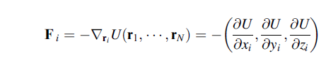
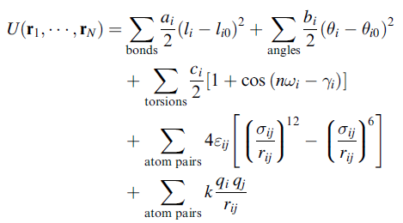
“Basic” equations for molecular dynamics used to simulate motions of biomolecules
Components for bond lengths and angles, bond rotation, van der Waals forces and electrostatic interactions
The force acting on the i^{th} atom (F_{i}) is given by the potential energy gradient caused by motion of the atom with respect to the other atoms

Slide 17
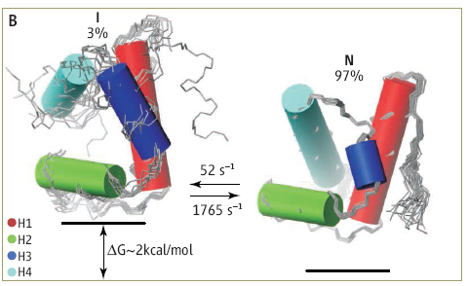
Low probability “excited” states are biologically important, serving as shorter-lived intermediates between more stable states.
Shown is the native (low-energy, energetically favorable) conformation of a protein (N) and its excited intermediate state.
Al-Hashimi 2010
Notes:
HYPA/FBP11 is a small 71-residue, four-helix bundle with H1(a)-H2(a)-H3(310)-H4(a) topology (20) that folds by a three-state mechanism involving an on-pathway intermediate (I): U↔I↔N (14, 21–23). Folding proceeds in two phases, including the fast formation of I from the unfolded state U (microsecond time scale) and a slower, rate-limiting transition from I to the natural state.

Slide 18
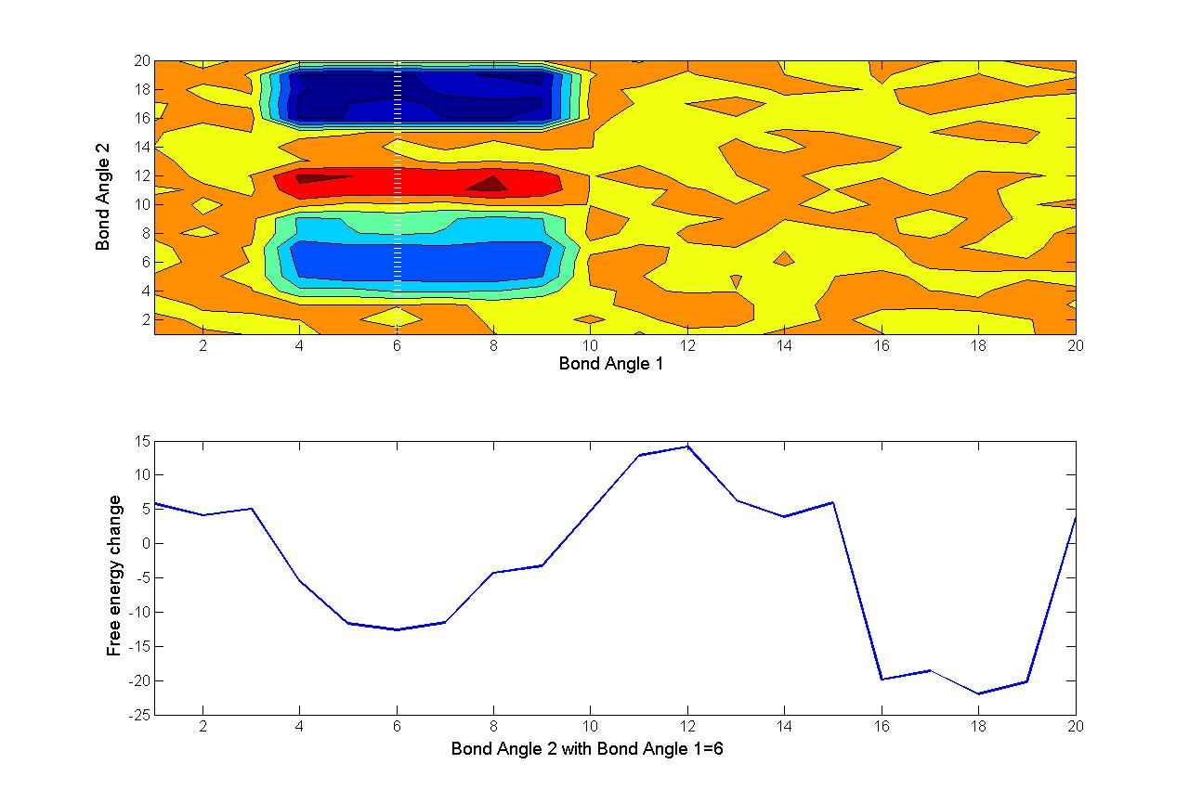
Top: 2D contour plot of free energy differences as a function of two bond angles (blue is lower). Bottom: Cross section of free energy differences when bond angle 2 is fixed
Can compute energetic cost function of different protein configurations to determine stable states
Computationally very expensive for a realistic sized protein
NOTE: A protein can be in a stable state without being in a global free energy minimum
Red box indicates range of free energy fluctuations due to thermal fluctuations
Local minimum (unstable)
Relative minimum (stable)
Global minimum (stable)

Slide 19
Clicker question: Which two peaks or troughs in the left figure correspond to the figure on the right?
C
A
D
B
E
C corresponds to the more probable conformation and A to the less probable one
C corresponds to the less probable conformation and A to the more probable one
D corresponds to the more probable conformation and E to the less probable one
B corresponds to the more probable conformation and E to the less probable one
E corresponds to the more probable conformation and D to the less probable one

Slide 20
The energy contour plot can also represent a protein that can transition between 2 stable conformations
C,D
E
C
62%
A
D
B
E
C,D
B
35%

Slide 21
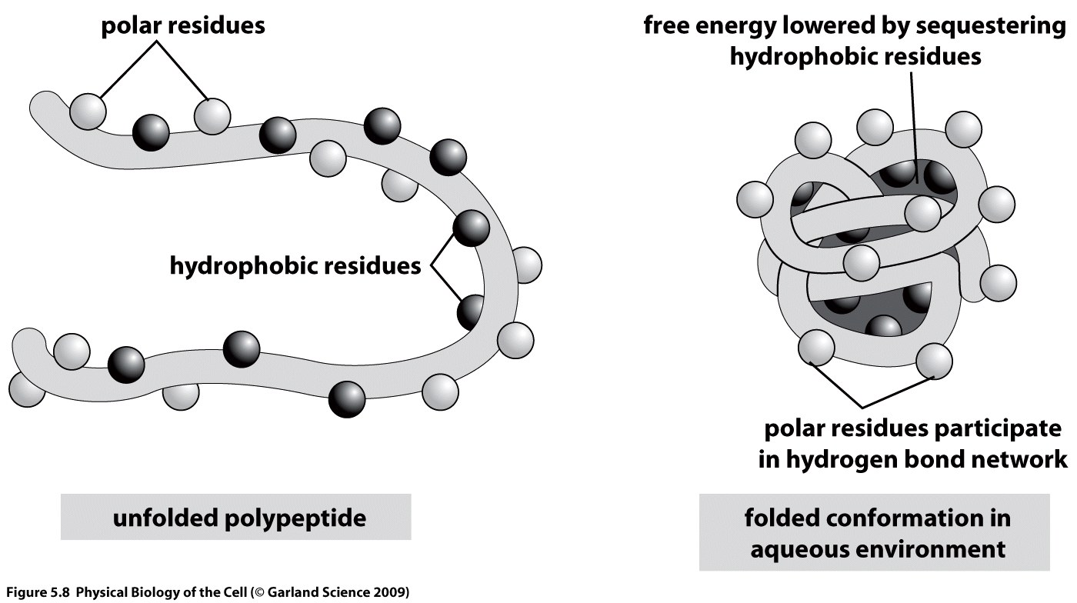
Shielding hydrophobic residues maximizes the entropy of the surrounding water, thereby lowering free energy

Slide 22
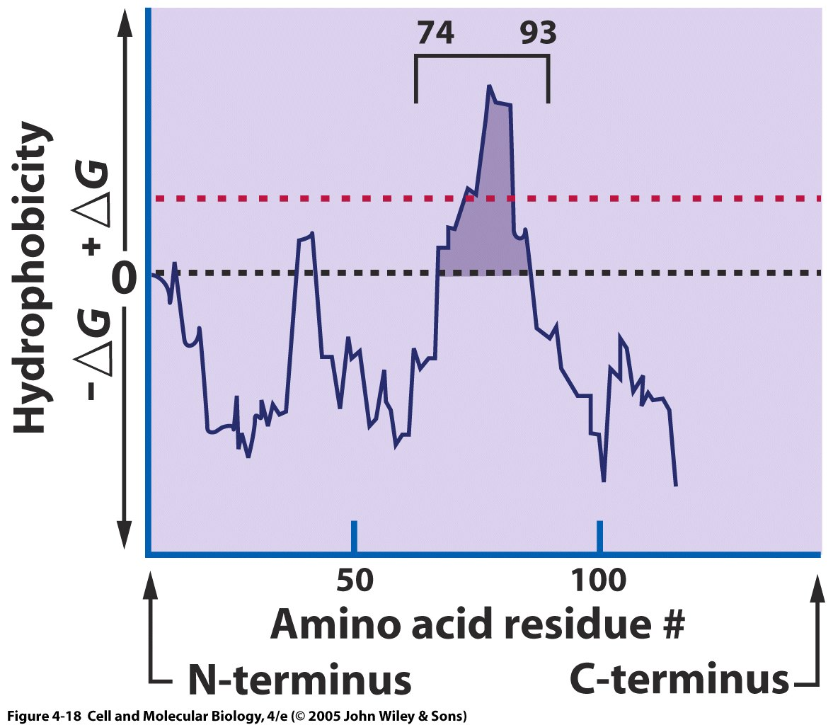
Hydropathy plots are used to identify membrane spanning regions of a protein
Hydropathy plots show the amount of free energy required to move amino acids to an aqueous medium (free energy of solvation).
Residues 74-93 are hydrophobic and likely to be membrane-spanning

Slide 23
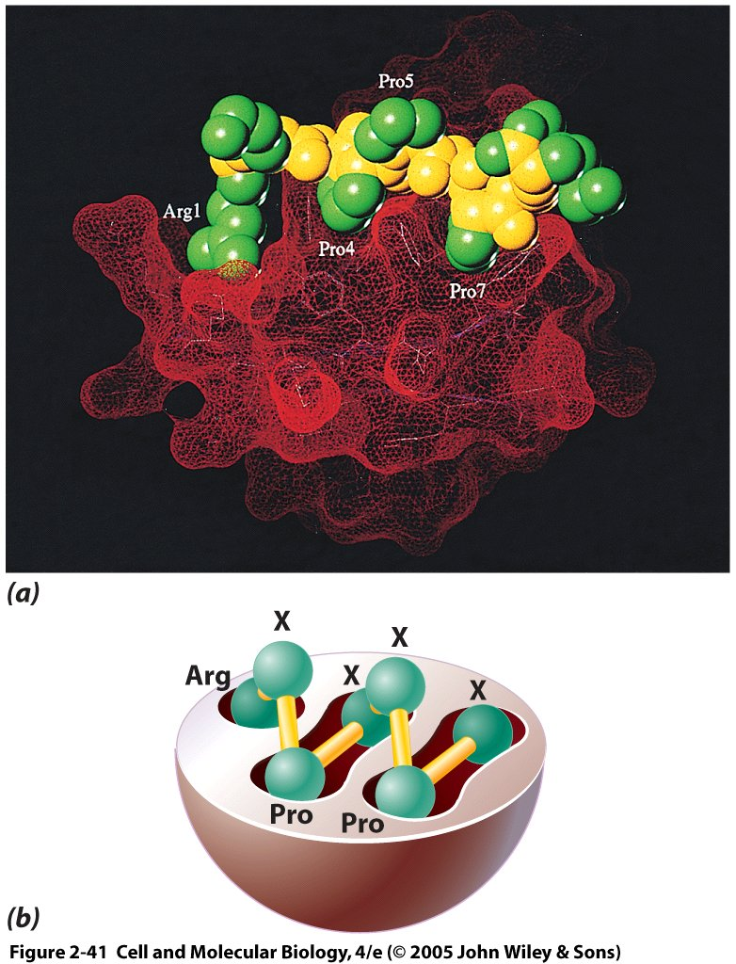
Specificity of protein-protein interactions is due to complementarity of spatial/electrostatic structure (minimizing the free energy again)
Pockets in the SH3 domain of phosphatidyl-inositol-3-OH kinase (red) fit proline rich proteins (yellow and green) well
Grooves shown schematically on bottom
Notes:
23

Slide 24
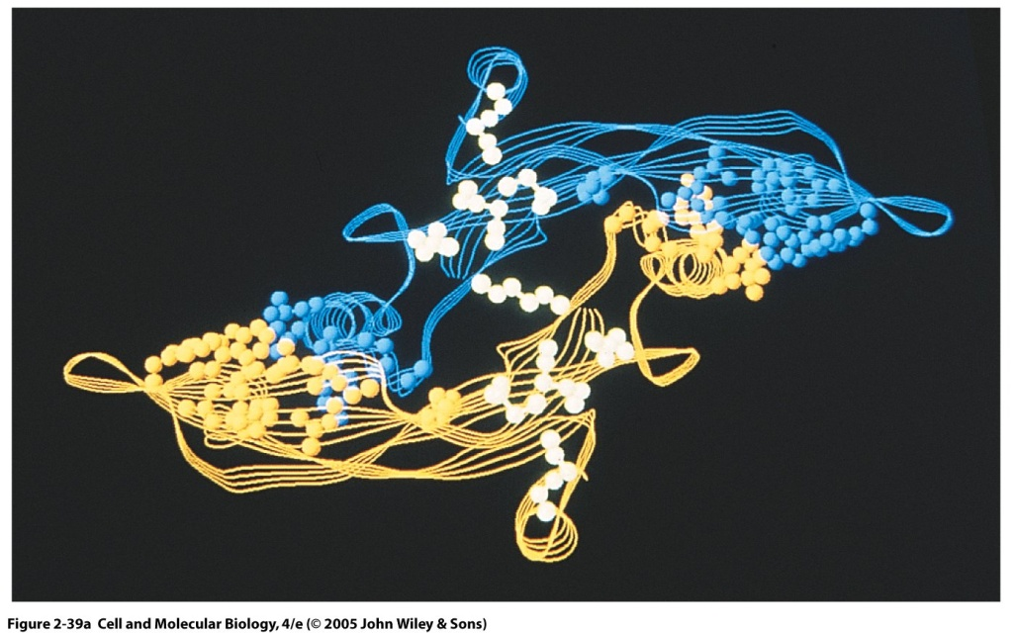
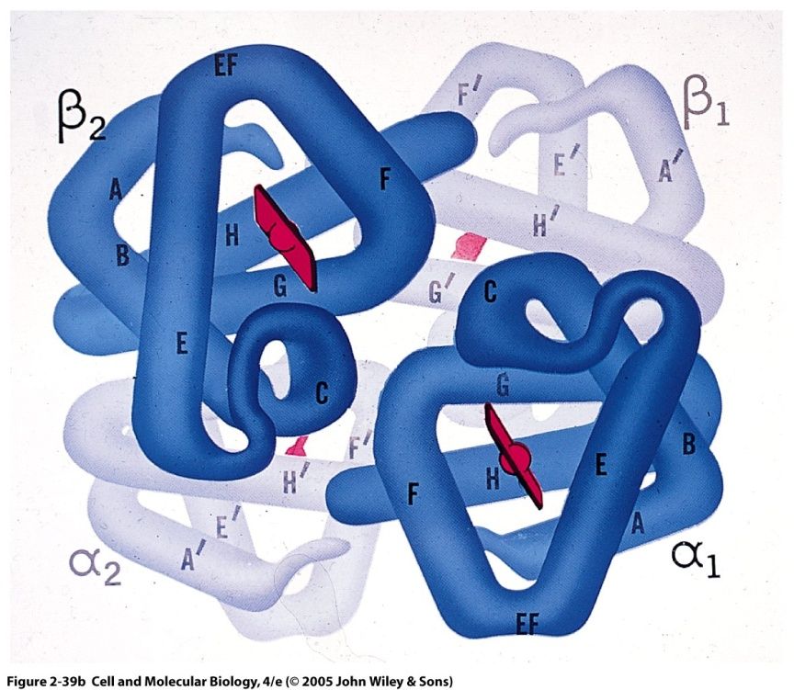
Quaternary protein structure occur when there are at least two protein subunits with tertiary structure
Different subunits are typically linked by non-covalent bonds
Left, transforming growth factor beta-2, consisting of two identical subunits (homodimer)
Right, hemoglobin, consisting of two alpha subunits and two beta subunits (heterotetramer, or two homodimers)
Review with video from Protein Data Bank: https://www.youtube.com/watch?v=qBRFIMcxZNM

Slide 25
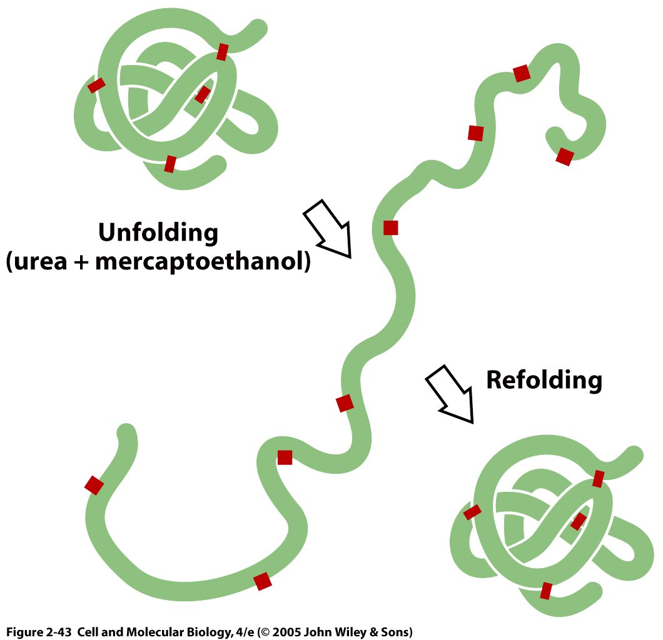
Many proteins’ conformations are repeatable and arise as a consequence of finding the lowest energy configuration
Don’t stress, relax!
The ability to re-form in a functional manner is called self-assembly.
Notes:
25
Urea denatures protein by getting into the hydrophobic core and reducing the hydrophobicity relative to its surroundings.

Slide 26
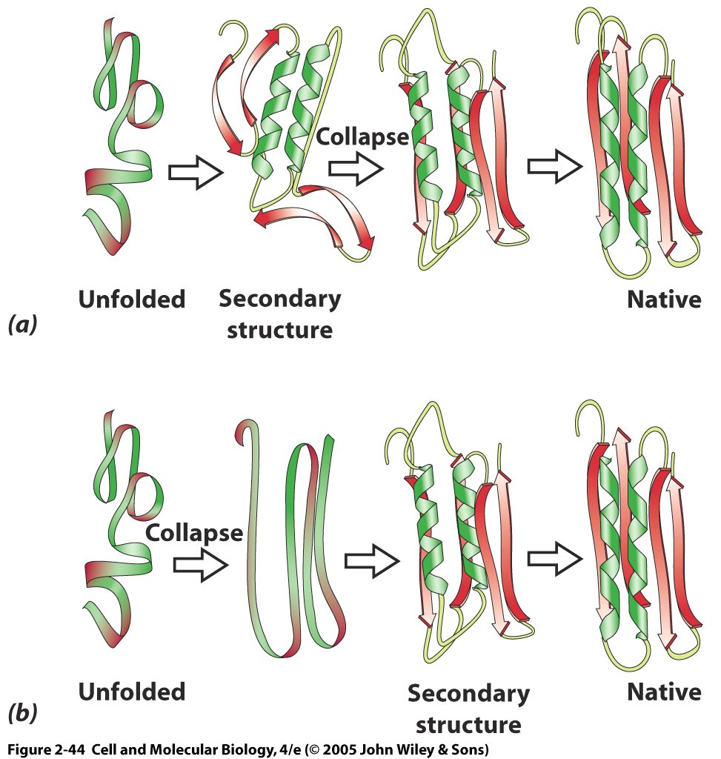
What are the steps in protein folding?
Scenario 1 (top): The unfolded chain forms secondary structure, and then tertiary structure through hydrogen bonding and hydrophobic interactions.
Scenario 2 (bottom): The unfolded chain compacts first, then forms secondary structure, and finalizes tertiary structure.
Actual folding is between these two extremes, simultaneous local formation of helices and sheets through local hydrogen bonding and hydrophobic interactions.
Notes:
26

Slide 27
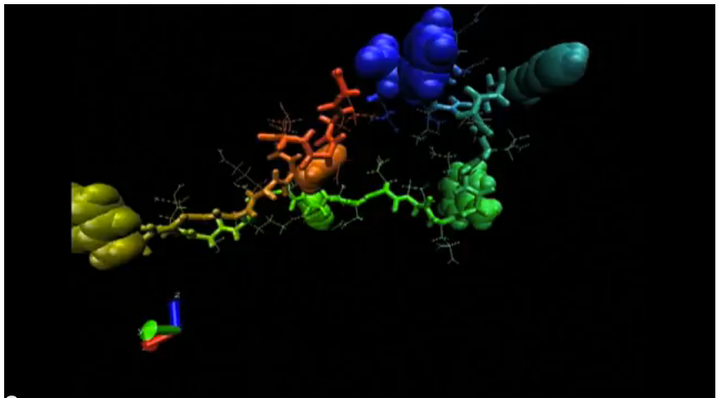
Video of protein folding
http://www.youtube.com/watch?v=1eSwDKZQpok

Slide 28
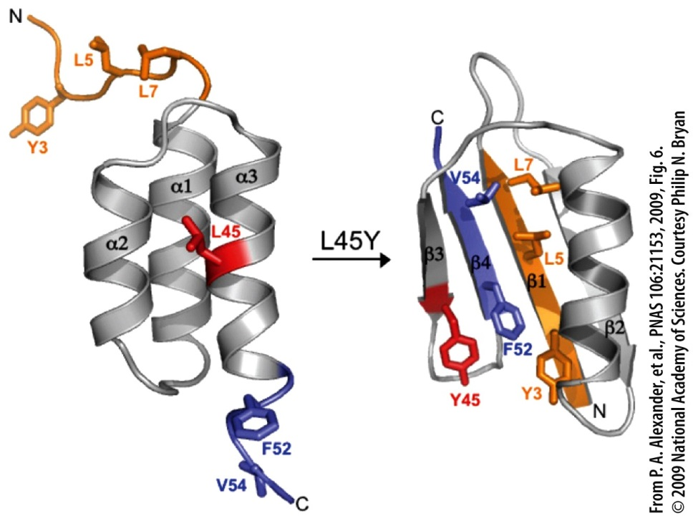
Protein structure alteration from a single amino acid change.
Four Types of Biological Molecules
Protein Adaptation and Evolution
Adaptations are traits that improve the chance of survival of an organism in a specific environment.
Proteins are subject to natural selection.
Members of a protein family are thought to have evolved from a single ancestor gene.
A particular protein may have different versions (isoforms) that are tissue- or stage-specific.
Notes:
Figure 2.54
The dramatic effect on conformation that can result from a single amino acid substitution. In this case the substitution of a leucine for a tyrosine at a critical position within this 56-amino acid polypeptide chain results in a transformation of the entire fold of the backbone of this polypeptide. This single substitution causes 85% of the amino acid residues to change their secondary structure. The spatial distribution of the two alternate side-chains, which brings about this conformational shift, is shown in the model structures. The N-terminal amino acids are shown in orange and the C-terminal amino acids in blue.

Slide 29
Phospholipase C is a multifunctional protein in prokaryotes and eukaryotes
Phospholipase C breaks (cleaves) the phospholipid PIP2 into DAG and IP3. DAG can lead to activation of protein kinase C, and IP3 leads to intracellular calcium. These are involved in many intracellular signaling pathways triggered by activation of membrane receptors.
Patterson et al. 2005

Slide 30
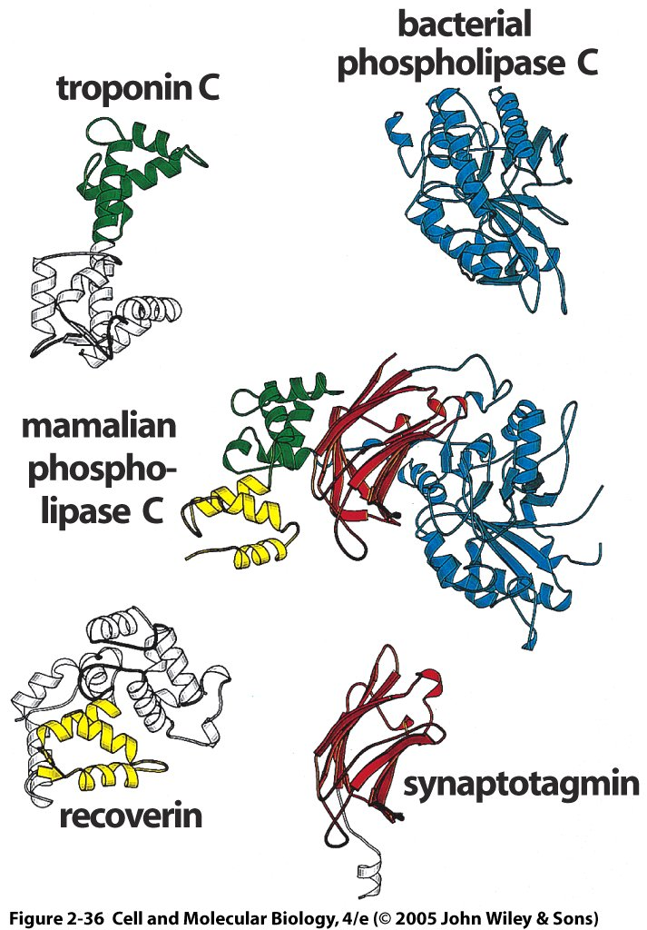
Larger proteins and more evolved proteins often consist of domains
Mammalian PLC consists of 4 domains:
Catalytic domain from bacterial PLC
Synaptotagmin (Ca2+ sensor)
Recoverin (Ca2+ triggered receptor)
Troponin C (binds Ca2+ to produce movement in muscle)

Slide 31
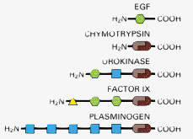
Domain shuffling: recycling on an evolutionary time scale
The same domains, such as the brown serine protease domains, are re-used in different cellular proteins, typically with the same functions across proteins. Modularity!
Alberts et al. Molecular Biology of the Cell

Slide 32
Clicker Question
What would you expect if two proteins had very similar protein domains?
The domain amino acid sequences would be conserved, meaning highly similar.
The domains would have similar quaternary structure.
The domains would have similar functions.
Answers A and C.
Answers B and C.
All of the above
Notes:
Answer is D or F. The major differences in the proteins would be the assembly of quaternary structure and the interfaces between subunits.

Slide 33
Summary
Macromolecules are defined by their atoms and the bonds the connect them.
Proteins come in a wide variety of sequences, sizes, and shapes
All molecular structures are Gibbs free energy minimizers
Protein components, or modules, are recycled and assembled by organisms on an evolutionary scale to form novel protein complexes

Slide 34
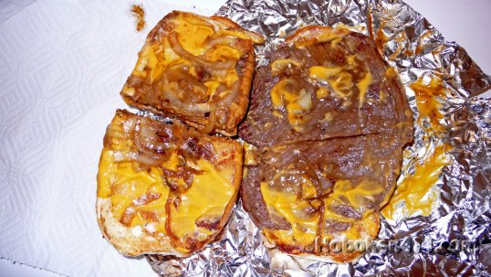
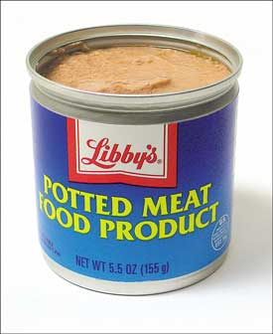
Mystery meat: Methods for protein identification, sequencing and interactions

Slide 35
Problem 1: Get a pure protein sample to analyze
What characteristics can be used to identify proteins?
Size
Charge
Enzymatic Activity
Sequence
Secondary structure
Interactions with other proteins
Location in cell (membrane bound, mitochondrial, nuclear, etc.)
Appearance during development (embryonic, adult, dividing, etc.)
Notes:
Let’s see how far the class can get with hints here.

Slide 36
The problem: Genomic and proteomic analyses have revealed thousands of proteins with unknown functions or interactions
Proteome = Inventory of proteins produced by an organism. It may be subdivided by cell type, tissue type, etc. Proteomics are studies of the proteome.
From Karp p. 68 – “The human genome contains roughly 25,000 genes, each of which can potentially give rise to a variety of different proteins. To date, only a fraction of these molecules have been characterized.”

Slide 37
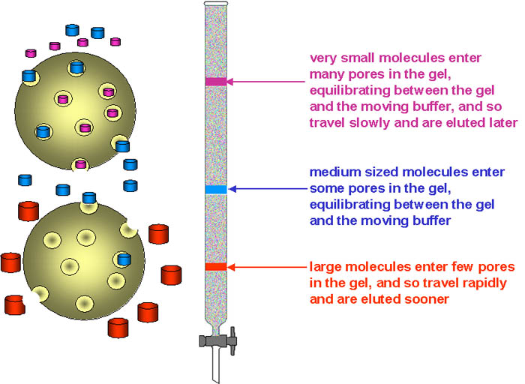
Gel exclusion chromatography (size filtration)
 | lower limit | upper limit
dextran gels
Sephadex G-50 | 1.5 | 30
Sephadex G-75 | 3 | 80
Sephadex G-100 | 4 | 150
Sephadex G-150 | 5 | 300
Sephadex G-200 | 5 | 600
polyacrylamide gels
Bio-Gel P-10 | 1.5 | 20
Bio-Gel P-30 | 2.5 | 40
Bio-Gel P-60 | 3 | 60
Bio-Gel P-100 | 5 | 100
Bio-Gel P-150 | 15 | 150
BioGel P-200 | 30 | 200
Bio-Gel P-300 | 60 | 400
dextran-polyacrylamide gels
Sephacryl S-200 | 5 | 250
Sephacryl S-300 | 10 | 1500
Sephacryl S-400 | 20 | 8000
agarose gels
Sepharose 6B | 10 | 4000
Sepharose 4B | 60 | 20,000
Sepharose 2B | 70 | 40,000
Bio-Gel A-0.5 | 10 | 500
Bio-Gel A-1.5 | 10 | 1500
Bio-Gel A-5 | 10 | 5000
Bio-Gel A-15 | 40 | 15,000
Bio-Gel A-50 | 100 | 50,000
http://www.ucl.ac.uk/~ucbcdab/enzpur/gelexcl.htm

Slide 38
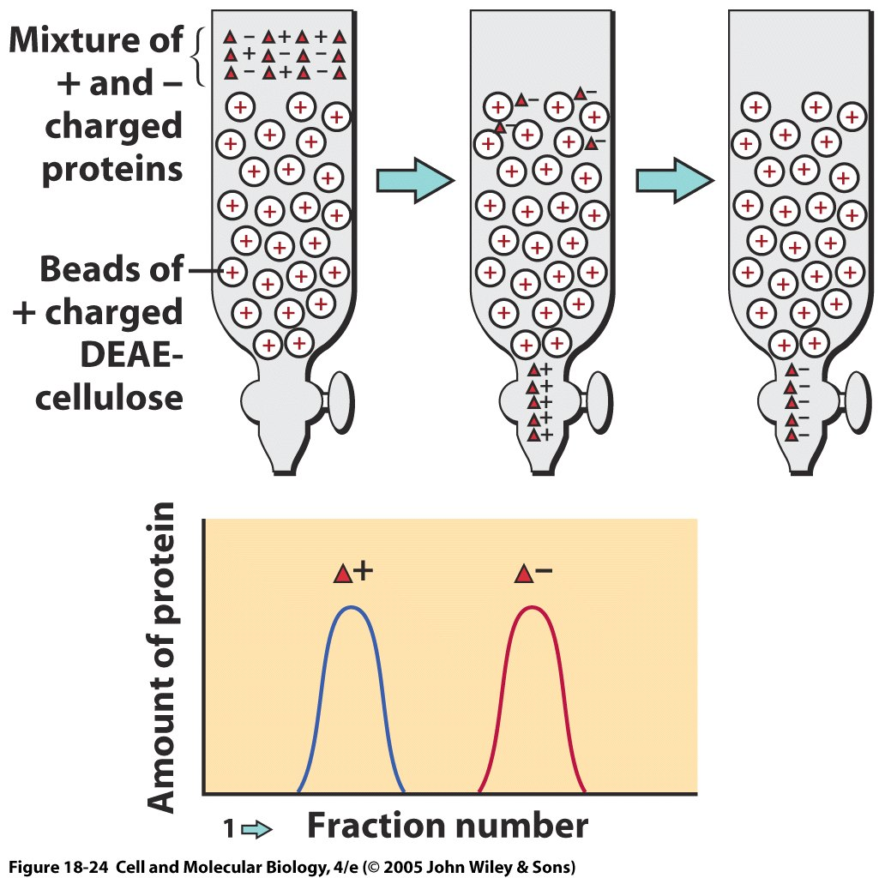
Chromatography
Mixture fractionated as it moves through a porous matrix
Mobile phase, protein in solvent
Immobile phase, protein caught in matrix
Fractions of solvent are captured at different time points
Proteins with least matrix affinity in first fraction, those with most in later fractions or captured in matrix
Notes:
This example shows ion-exchange chromatography

Slide 39
Ion-exchange chromatography
Use charged matrix to attract oppositely charged proteins
Can vary pH of solvent to vary protein charge (Why?)
Isoelectric point = the pH at which the protein is neutral (typically not pH=7)
Can also have gel-filtration chromatography (by size)
Notes:
This example shows ion-exchange chromatography

Slide 40
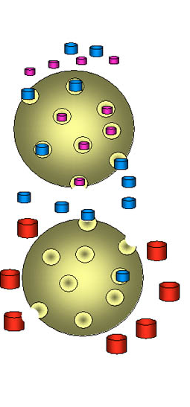
Clicker Question: What is true regarding Gel filtration or gel exclusion chromatography?:
Small molecules have a faster average velocity, and hence elute earlier from the column.
Small molecules have a slower average velocity, and hence elute earlier from the column.
Large molecules have a faster average velocity, and hence elute earlier from the column.
Large molecules travel slower average velocity, and hence elute earlier from the column.
Notes:
Answer is C

Slide 41
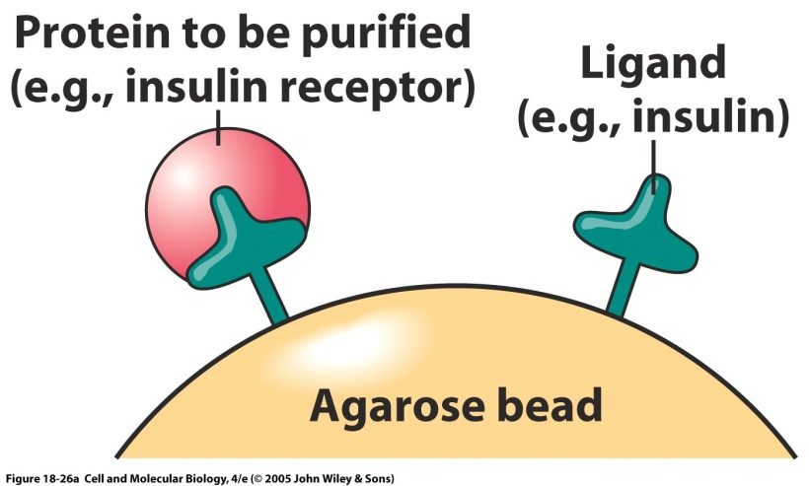
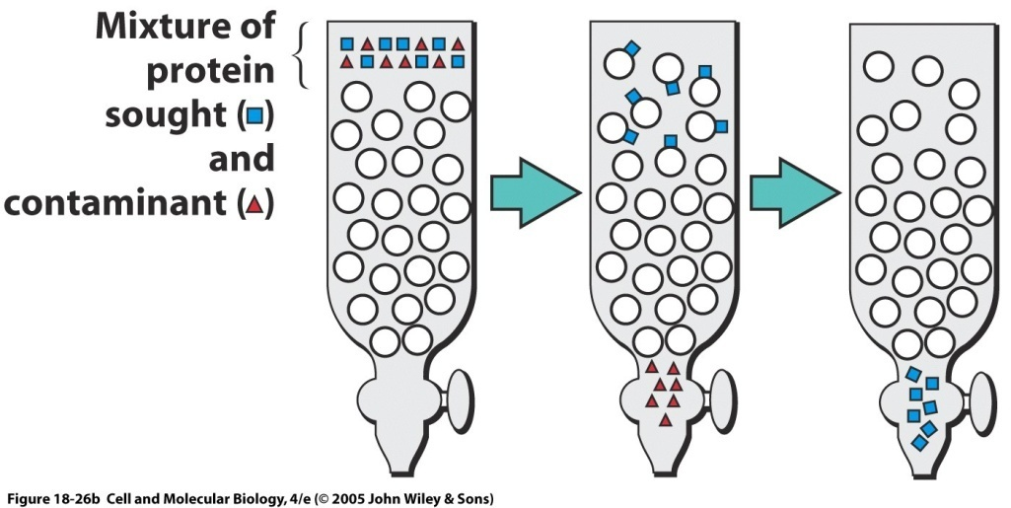
Affinity chromatography
Useful if you have a known or desired target or ligand
Only proteins that bind to the target will remain in the column
Can dissociate bound protein by changing pH
Depending on initial protein mixture, may get closely related proteins or multiple bound proteins

Slide 42
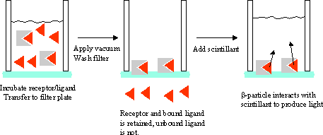
How do you know you have the right protein?
Enzyme assays. If the solution loses the ability to catalyze a reaction, then the enzyme has either passed through the column or is bound in the matrix.
Binding assays. Typically, a radioactive ligand is put together with your protein of interest (a receptor usually). Unbound ligand is removed. Radioactive decay is detected with a scintillation counter.
Sequence it. Sequencing lab or…mass spectrometry
http://www.ncgc.nih.gov/guidance/section5.html#filtration-assays

Slide 43
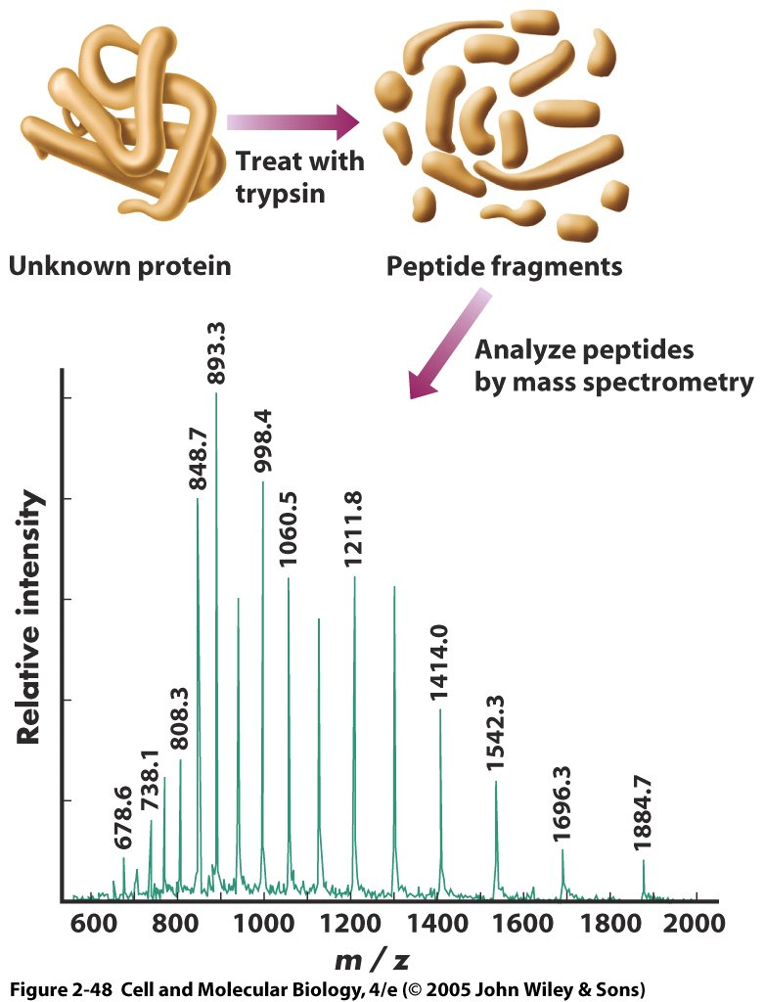
Mass spectrometry, it’s a gas!
Widely used and powerful way to identify and sequence a protein
First, digest the protein enzymatically to break it into small peptide fragments
Then, vaporize it. In matrix-assisted laser desorption ionization (MALDI), the protein is embedded in a crystal matrix that is vaporized by a laser pulse. The crystal matrix contains materials which will serve as reference points in the mass spectrogram.
In electrospray ionization (ESI), the protein solution is vaporized by application of an electric potential. The protein solution could be obtained from a fraction from chromatography
Notes:
43
http://www.youtube.com/watch?v=a5aLlm9q-Xc
Matrix-Assisted Laser Desorption Ionization (MALDI) typically utilizes a nitrogen laser at 337nM as the ionization source. The sample is mixed with a matrix, and allowed to dry prior to insertion into the mass spectrometer. Crystallization of the sample within the matrix is an important component of successful MALDI analysis. A variety of matrices, present in great excess relative to the sample amount, are used to span the range of compounds classes amenable to MALDI mass analysis. Formation of sample ions, upon laser irradiation, involves a proton transfer reaction involving the matrix (which absorbs the UV photon) and the analyte. The ions are then accelerated into a time-of-flight mass analyzer for mass analysis. Typical matrices include, a-cyano-4-hydroxycinnamic acid, sinapinic acid and 2,5-dihydroxybenzoic acid. MALDI can be done routinely to m/z 100,000 and there are many examples of analyses going well above this mass range

Slide 44
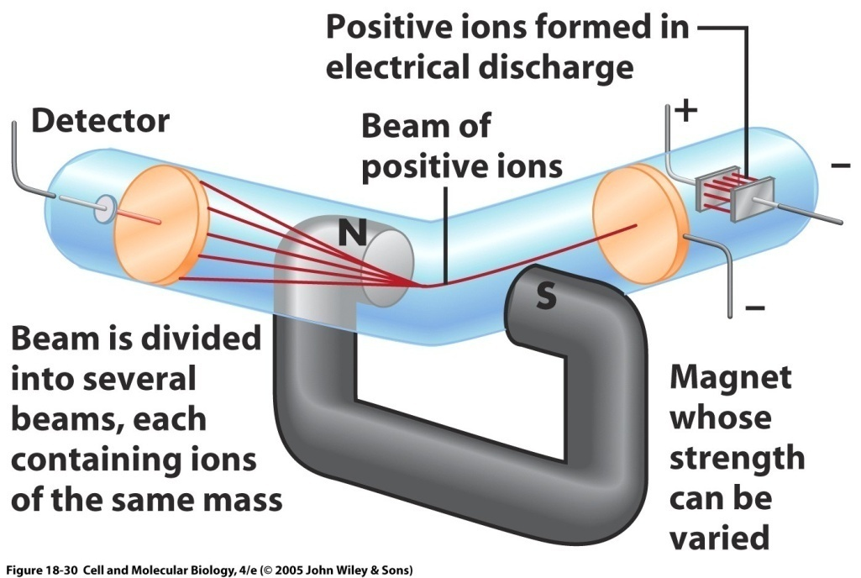
Mass spectrometry 2
Vaporized peptide fragments pass through a magnetic field that separates them by their mass/charge ratio (m/z ratio).
The ions are accelerated and then deflected by the magnet according to their mass. Lighter fragments are deflected more.
The ion flux (number of ions/unit time) is detected at the detector for each mass, separated by time of arrival and position on detector.
Notes:
44

Slide 45
Mass spectrometry 3
Each protein will have a signature in the mass spectrometer
Can be compared with a database
Or some fragments can undergo another round of mass spectrometry at a finer level of detail to reveal the amino acid sequence, which is called tandem mass spectrometry.
In this case, fragments with a selected mass pass through a second mass spectrometer
Notes:
45

Slide 46
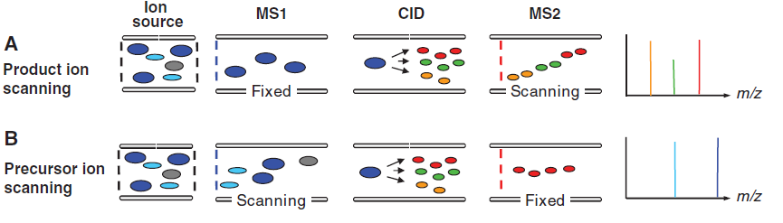
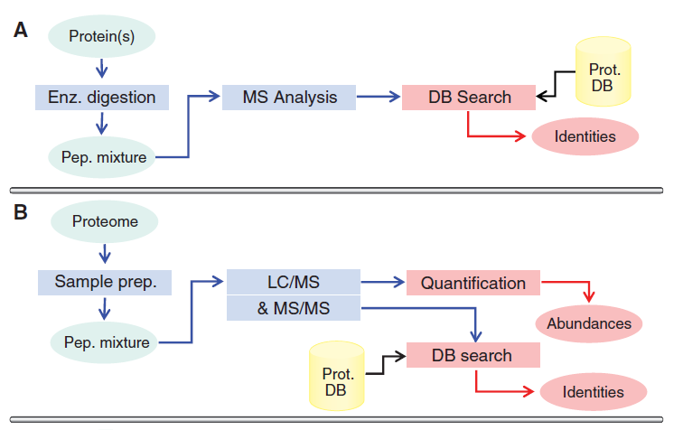
Two common types of tandem mass spectrometry and their workflow
In each, they go through two rounds of fragmentation, at the ion source or before that (not shown) and in the collision cell, where collision induced dissociation (CID) occurs. They also go through two mass spectrometry chambers where fragments with specific m/z are selected.
Domon and Aebersold 2006

Slide 47
What if you have a mixture of unknown proteins or want to compare proteins across species or manipulations?
Modern mass spectrometry, especially tandem mass spectrometry, works quite well, but it requires more complicated analysis and can be expensive
Earlier and current methods often use another technique called…
Notes:
47

Slide 48
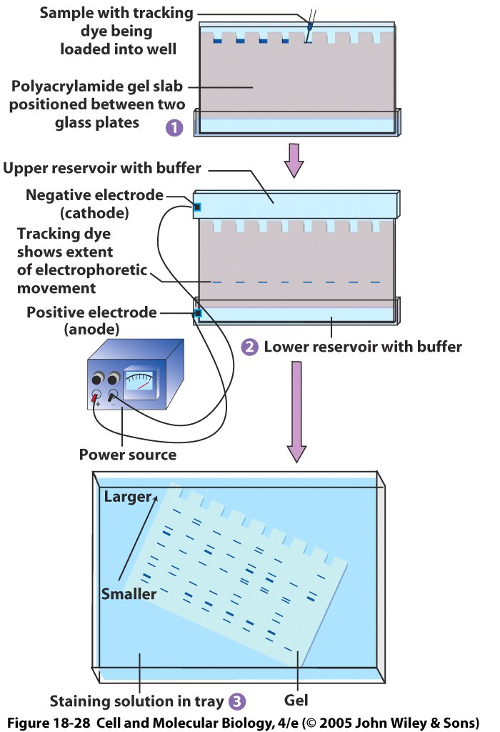
Gel electrophoresis
Can be one or two dimensional
Separate proteins by size and/or isoelectric point
Similar to chromatography in that a matrix alters movement of a protein.
Commonly use SDS-PAGE, or sodium dodecyl sulfate polyacrylamide gel electrophoresis.
Negatively charged SDS attach all over proteins and put in a voltage gradient.
Larger proteins move more slowly and remain near the top of the gel.
Example of one dimensional electrophoresis (size). Each column is a different sample.
Notes:
48
In SDS PAGE, SDS equalizes charge density of all proteins and only separator is mass

Slide 49
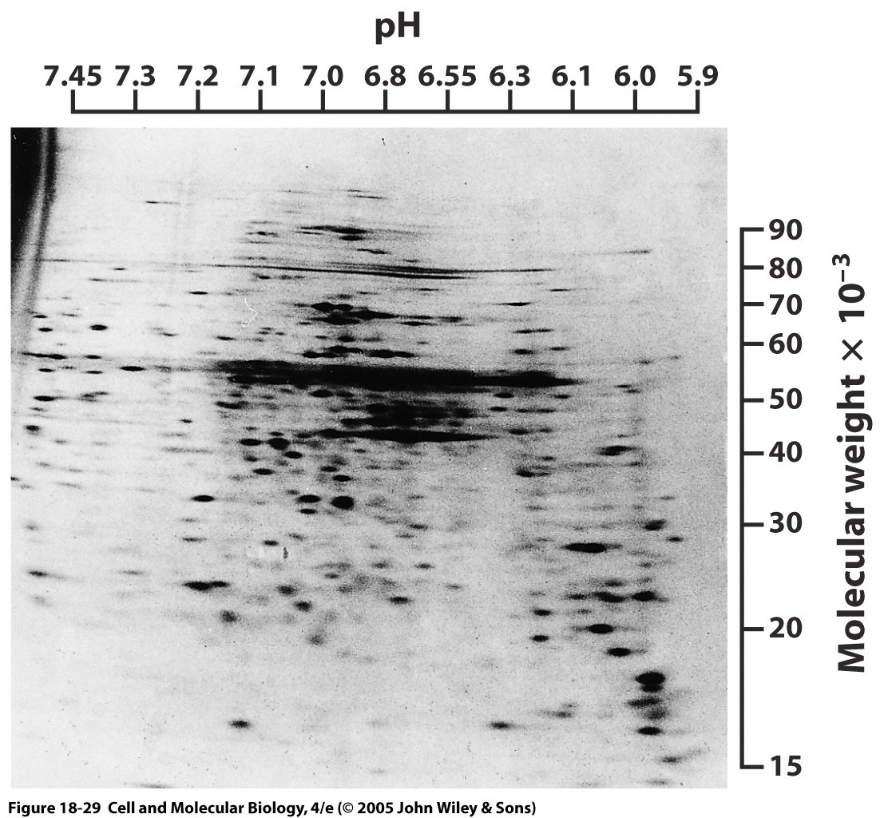
Two-dimensional gel electrophoresis
Two dimensions are typically mass and isoelectric point, the point at which the protein is neutral.
Can segregate most proteins in a cell simultaneously like this.
Notes:
49

Slide 50
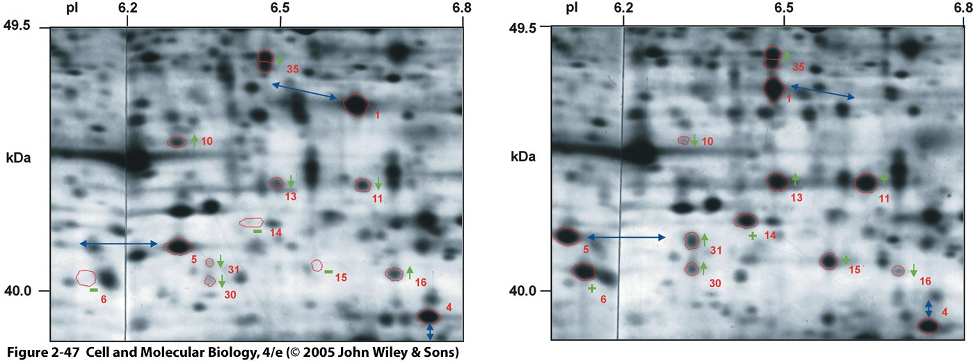
Application of two-dimensional gel electrophoresis to compare human and chimpanzee proteins
Overall pattern is very similar between human (left) or chimpanzee tissue samples from frontal cortex (right)
Circled regions highlight differences between species, either as a shift in the position on the gel or in the intensity of the spot (amount of protein)
Proteins of interest can then be studied further, sometimes by simply removing the stained portion of interest containing the protein.
Notes:
50

Slide 51
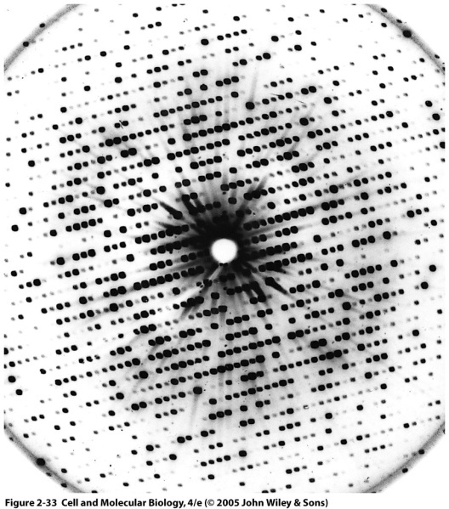
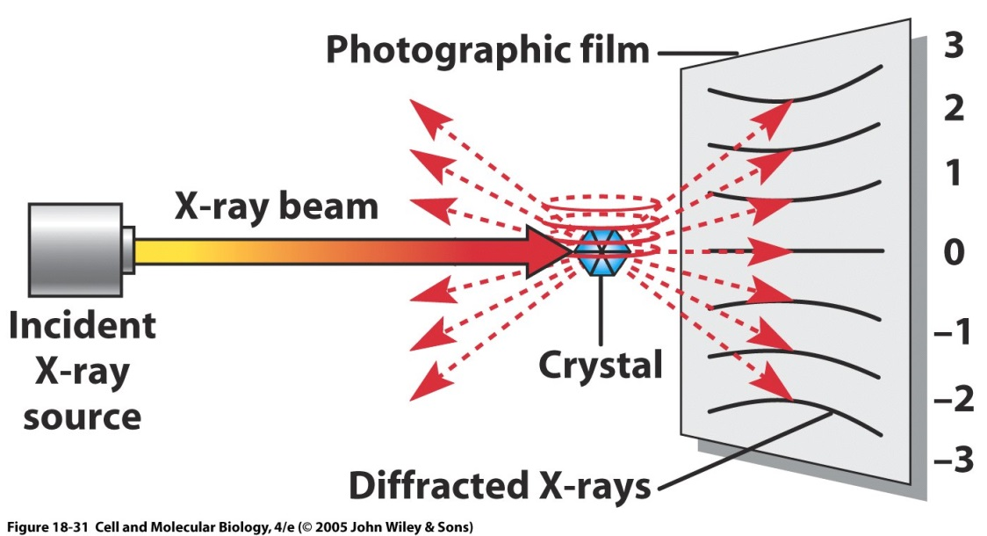
X-ray diffraction can provide a high-resolution picture of protein tertiary crystal structure
Typical diffraction pattern
Sample must be a crystal, because need ordered repeating structure. Crystal creation lies at the science/magic interface (kidding, mostly)
A very short wavelength x-ray beam produces an interference pattern based on the positions of the atoms in the sample
The sample or beam can be moved to get the structure from all angles.
Notes:
51
Remember from physics that diffraction is the bending of a wave as it passes through an aperture or by an object
asinθ = nλ for a double slit, where a is the distance between slits and gives location of maximal interference
I. Steps in X-ray diffraction (X-ray crystallography) – must get most purified preparation of protein possible
A. Protein crystals are needed before X-ray crystallography can be used to characterize proteins
1. Crystal is composed of a regularly repeating arrangement of a unit cell (a single protein)
2. The ability to make a protein crystal is one of the best guarantees of molecular purity
B. Protein crystal, once formed, is bombarded with a fine X-ray beam of monochromatic wavelength
1. Radiation that is scattered (diffracted) by electrons of protein's atoms strikes an electron-sensitive detector placed behind the crystal
2. Diffraction pattern produced by the crystal is determined by the structure within protein; atoms in the crystal are in a repeating pattern,
3. The large number of molecules in crystal reinforces reflections —> it behaves like one large molecule
II. Data obtained
A. Reflection positions & intensities on plates are related mathematically to protein electron densities, since it is the electrons of the atoms that produced them; reflections appear as spots on plates
1. Because of the way in which the crystal is bombarded, each plate represents a slice of molecule; one must analyze many plates to get a single diffraction pattern
2. Resolution obtained by X-ray diffraction depends on the number of spots that are analyzed
B. Spots closer to pattern center result from X-rays scattered at smaller angles from crystal; provide information about grosser aspects of protein (long spacings within molecule)
C. Spots closer to periphery of photograph contain information about closely spaced aspects of molecules within crystal —> resolution depends on the number of spots analyzed
III. Example: myoglobin, first protein whose structure was determined by X-ray diffraction; analyzed successively at resolutions of 6, 2 & 1.4 Å, with years elapsing between each completed determination
A. Since covalent bonds are 1 - 1.5 Å in length & noncovalent bonds are between 2.8 Å & 4Å in length, information gathered on protein depends on resolution achieved
B. In myoglobin, at 6 Å resolution —> showed manner in which myoglobin polypeptide chain is folded & the location of the heme moiety, but it is not sufficient to show structure within chain
1. At 2 Å resolution —> groups of atoms could be separated from one another
2. At 1.4 Å resolution —> positions of individual atoms were determined
C. By the end of 2002, the structure of >250 proteins had been determined at atomic resolution (>1.2 Å) & a handful as low as 0.8 Å
http://www.youtube.com/watch?v=ejqleVj4plE

Slide 52
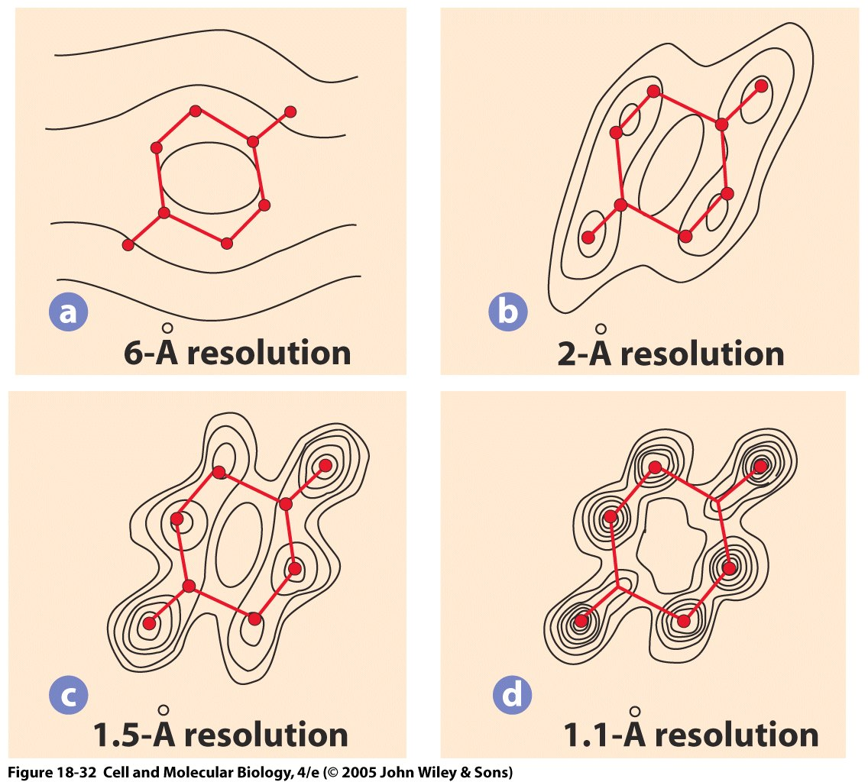
X-ray diffraction can give extremely precise structural information
Down to ≤1 angstrom, where individual electron density patterns can be detected
Resolution near 3 angstroms required for estimating atom relationships
Computational power for reconstructing diffraction patterns enables tertiary structure calculations within a day
Difficult for membrane proteins, because structure often changes if removed from membrane
Notes:
52

Slide 53
Minor et al. 2007

Slide 54
Crystal structure of p53 tumor suppressor protein
trans-activation
tetramerization
4 repeated subunits around central domain
Each subunit consists of a DNA-binding domain and a trans-activation domain.
From Protein Data Bank,
www.rcsb.org
DNA-binding
Notes:
p53 is a tumor suppressor protein that in humans is encoded by the TP53 gene. p53 is crucial in multicellular organisms, where it regulates the cell cycle and, thus, functions as a tumor suppressor that is involved in preventing cancer. As such, p53 has been described as "the guardian of the genome" because of its role in conserving stability by preventing genome mutation.

Slide 55
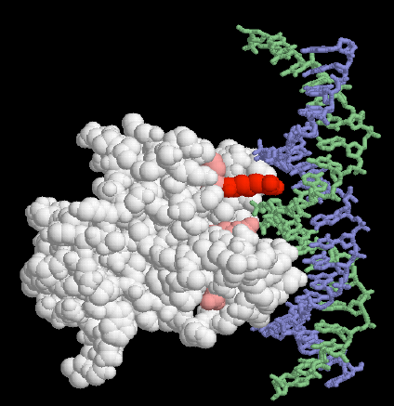
DNA binding domain of p53 along DNA chain
DNA on right
P53 DNA-binding domain on left, with key arginine in DNA minor groove in red.
Other important amino acids in pink.
Notes:
p53 is a tumor suppressor protein that in humans is encoded by the TP53 gene. p53 is crucial in multicellular organisms, where it regulates the cell cycle and, thus, functions as a tumor suppressor that is involved in preventing cancer. As such, p53 has been described as "the guardian of the genome" because of its role in conserving stability by preventing genome mutation.

Slide 56
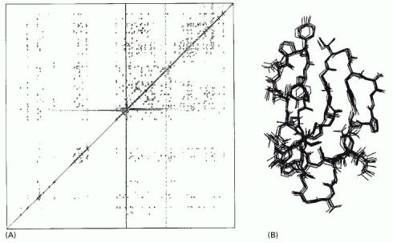
Nuclear magnetic resonance (NMR) spectroscopy
Example protein: cellulase. Left: Two-D NMR spectrum. Right: Reconstructed structures satisfying constraints.
Chemical Shift RF-B
Alberts et al., Molecular Biology of the Cell
Chemical Shift- RF-A
NMR can bypass main constraint of x-ray crystallograpy because it requires protein in a solution, rather than a crystal.
Measures the emitted radiation from hydrogen atoms that have been forced to align by a strong magnetic field.
Can monitor changes in structure with binding, etc.
Notes:
56
http://www.cem.msu.edu/~reusch/VirtualText/Spectrpy/nmr/nmr1.html
http://www2.chemistry.msu.edu/faculty/reusch/VirtTxtJml/Spectrpy/nmr/nmr1.htm
may operate by sweeping the magnetic field. Using this terminology, we would find that at 2.34 T the proton signals shown above extend over a 4,200 Hz range (for a 100 MHz rf frequency, 42 ppm is 4,200 Hz). Most organic compounds exhibit proton resonances that fall within a 12 ppm range (the shaded area), and it is therefore necessary to use very sensitive and precise spectrometers to resolve structurally distinct sets of hydrogen atoms within this narrow range. In this respect it might be noted that the detection of a part-per-million difference is equivalent to detecting a 1 millimeter difference in distances of 1 kilometer.
Nice NMR tutorials
Unlike x-ray crystallography, NMR does not depend on having a crystalline sample; it simply requires a small volume of concentrated protein solution that is placed in a strong magnetic field.
Certain atomic nuclei, and in particular those of hydrogen, have a magnetic moment or spin: that is, they have an intrinsic magnetization, like a bar magnet. The spin aligns along the strong magnetic field, but it can be changed to a misaligned, excited state in response to applied radiofrequency (RF) pulses of electromagnetic radiation. When the excited hydrogen nuclei return to their aligned state, they emit RF radiation, which can be measured and displayed as a spectrum.
Chemical shift is the change in resonant frequency due to the local environment. Small changes in frequency 100 Hz out of 100-900 MHz. In 2-D NMR shown, experiment is a series of RF pulses whose characteristics are highly controlled. Off-diagonal peaks are coupled hydrogens. Often pulse interval varied.
For technical reasons the structure of small proteins of about 20,000 daltons or less can readily be determined by NMR spectroscopy. Resolution is lost as the size of a macromolecule increases. But recent technical advances have now pushed the limit to about 100,000 daltons, thereby making the majority of proteins accessible for structural analysis by NMR.
The NMR method is especially useful when a protein of interest has resisted attempts at crystallization, a common problem for many membrane proteins. Because NMR studies are performed in solution, this method also offers a convenient means of monitoring changes in protein structure, for example during protein folding or when a substrate binds to the protein. NMR is also used widely to investigate molecules other than proteins and is valuable, for example, as a method to determine the three-dimensional structures of RNA molecules and the complex carbohydrate side chains of glycoproteins.
Figure 8-46. NMR spectroscopy. (A) An example of the data from an NMR machine. This two-dimensional NMR spectrum is derived from the C-terminal domain of the enzyme cellulase. The spots represent interactions between hydrogen atoms that are near neighbors in the protein and hence reflects the distance that separates them. Complex computing methods, in conjunction with the known amino acid sequence, enable possible compatible structures to be derived. In (B) 10 structures, which all satisfy the distance constraints equally well, are shown superimposed on one another, giving a good indication of the probable three-dimensional structure. (Courtesy of P. Kraulis.)

Slide 57
Additional links for NMR principles
http://chem.ch.huji.ac.il/nmr/whatisnmr/whatisnmr.html
https://www2.chemistry.msu.edu/faculty/reusch/virttxtjml/spectrpy/nmr/nmr1.htm

Slide 58
Flowchart of sample preparation for cryo-EM
From Cheng et al. 2015. Cell 161, April 23, 2015
Notes:
Figure 1. The Steps Involved in Structure Determination by Single-Particle Cryo-EMA single-particle project should start with a characterization of the specimen in negative stain (left arm of the workﬂow). Only once the EM images, or potentially 2D class averages, are satisfactory, i.e., the particles are mono-disperse and show little aggregation and a manageable degree of heteroge-neity (‘‘low-resolution’’ sample reﬁnement), is the sample ready for analysis by cryo-EM (right arm of the workﬂow). The images, 2D class averages and 3D maps obtained with vitriﬁed specimens may indicate that the sample requires further improvement to reach near-atomic resolution (‘‘high-resolution’’ sam-ple reﬁnement).

Slide 59
Structure of 20S proteasome subunit by cryo-EM
The proteasome controls the degradation of proteins within the cell in order to control the duration of protein effect or remove damaged proteins.
Notes:
Figure 1. Single-Particle Cryo-EM(A) Puriﬁed biological molecules are embedded in a thin layer of vitreous ice, in which they ideally adopt random orientations. The orientations are speciﬁed by the in-plane position parameters, x and y, and three Euler angles a, b, and g, which are reﬁned iteratively to high accuracies. The defocus values of the images are currently often determined separately.(B) Typical image of frozen-hydrated archaeal 20S proteasomes.(C) 3D reconstruction of the 20S proteasome at 3.3-A˚ resolution.(D) Side-chain densities of the map shown in (B) are comparable with those seen in maps determined by X-ray crystallography at a similar resolution.

Slide 60
Cryo-EM can show detailed bacteriophage structure, resolution proportional to acceleration of electron beam
Jiang et al. 2006, Wen Jiang is in Bio. Dept, Purdue University
Notes:
60
60
Cryo-EM = cryo-electron microscopy
Figure 1 | Structure of epsilon15
bacteriophage. a, 200-kV CCD
image of epsilon15 particles
embedded in vitreous ice. b, Surface
rendering of the 20A ° resolution
three-dimensional map of entire
epsilon15 bacteriophage
reconstructed without symmetry
imposition. The capsid (dark green)
exhibits good icosahedral symmetry
as indicated by the icosahedral
lattice (grey). c, d, The structural
components of epsilon15
bacteriophage are annotated in the
central section density (c) and the
cut-away surface view (d) of the
three-dimensional density map.
Each of the structural components
is coloured differently and the same
colour scheme is used in Figs 1–3.
e, A slightly tilted view of the
coaxially packed dsDNA genome.
Only portions of the first and
second layers of dsDNA are shown
so that the three outermost layers
can be viewed. Colour gradient (light
blue to darker blue) is used in d and
e to indicate the likely packaging
order of the dsDNA starting from
the outer layer towards inner layers
and ending as the central straight
segment of terminus.

Slide 61
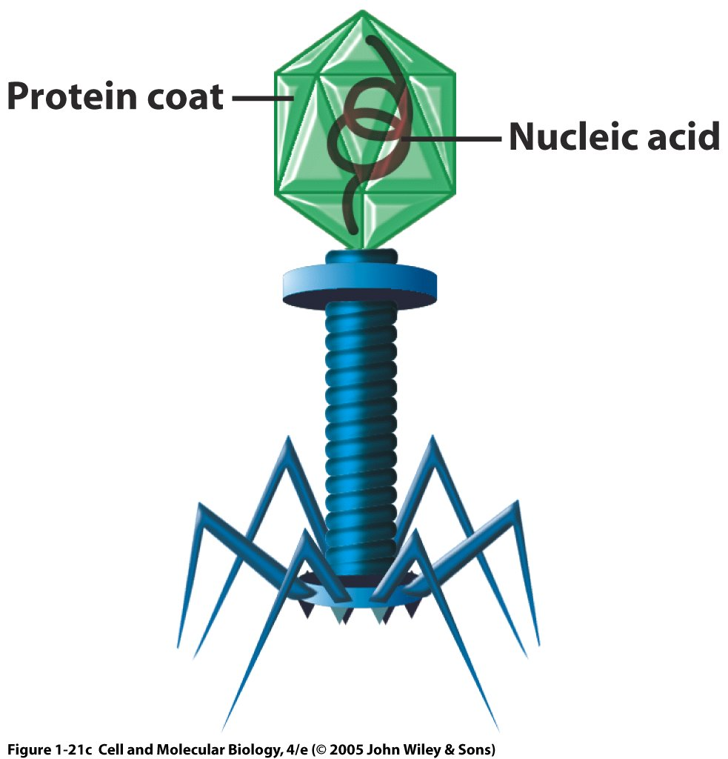
Bacteriophages are complex viruses that infect bacteria.
They consist of:
A polyhedral head that contains DNA
A stalk through which DNA is injected
Tail fibers to attach to bacteria
Notes:
61
61
Bacterial viruses (bacteriophages) are among most complex – T bacteriophages polyhedral head (contains DNA), cylindrical stalk (injects DNA into bacterium) & tail fibers (attach to bacteria)
1. Used in key experiments that revealed genetic material structure & properties

Slide 62
Zika virus was reconstructed at Purdue by cryo-EM!
Notes:
Fig. 1. The cryo-EM structure of Zika virus at 3.8Å. (A) A representative cryo-EM image of frozen, hydrated ZIKV showing the distribution of virion phenotypes. Smooth, mature virus particles are identified by a surrounding black box. A partially mature virus particle is identified by the yellow arrow. (B) A surface-shaded depth cued representation of ZIKV viewed down the icosahedral two-fold axis. The asymmetric unit is identified by the black triangle. (C) A cross-section of ZIKV showing the radial density distribution. Panels B and C are color-coded based on the following radii: up to 130Å, blue; 131Å to 150Å, cyan; 151Å to 190Å, green; 191Å to 230Å, yellow, from 231Å, red. The region shown in blue fails to follow icosahedral symmetry and therefore its density is uninterruptable as is the case with other flaviviruses. (D) A plot of the Fourier shell coefficient (FSC). Based on the 0.143 criterion for the gold standard comparison of two independent data sets, the resolution of the reconstruction is 3.8Å. The x axis shows 1/resolution in Å−1; the y axis shows the FSC value. (E) The Cα backbone of the E and M proteins in the icosahedral ZIKV particle (same orientation as in Panel B above) showing the herringbone organization. The color code fits the standard designation of E protein domains I (red), domain II (yellow) and domain III (blue). (F) Representative cryo-EM electron densities of several amino acids of the E protein.

Slide 63
Two of the main subunits of the Zika viral envelope
Notes:
Fig. 2. The structures of Zika virus E and M proteins. (A) The E protein dimer is shown in ribbon form viewed down the two-fold axis. The color code fits the standard designation of E protein domains I (red), domain II (yellow) and domain III (blue). The underlying stem and transmembrane residues are shown (pink). The fusion loop (green; fig. S1), Asn154 glycan, and the variable loop surrounding the Asn154 glycan (residues 145-160, cyan) are highlighted. (B) Side view of the E-M dimer showing the three E ectodomains as well as the E stem/transmembrane domains (pink) and the M loop and stem/transmembrane domains (light blue). The E and M transmembrane domains are found within the lipid bilayer (Fig. 1C). All residues of M (1-75) and all but three residues of E (1- 501) were identified in the density. The Asn154 glycan from one monomer is labeled and can be seen projecting from the surface.

Slide 64
Now we have been able to identify the sequence and structure of one protein. Can we find out anything about who the protein interacts with?
Notes:
64

Slide 65
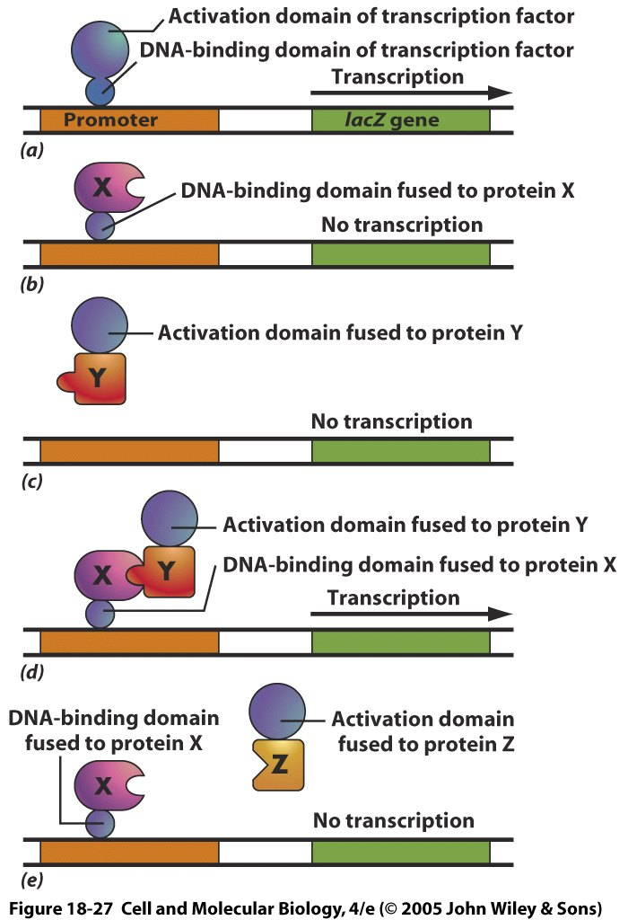
The yeast two-hybrid system detects interactions
(Top) Normal case. Activation domain and DNA binding domain needed for transcription of lacZ (beta-galactosidase reporter gene)
If only DNA binding domain fused to protein X, no transcription.
A battery of potential protein Ys are bound to an activation domain
Only when an interaction occurs with protein X (shown in d but not e) will transcription occur.
Notes:
65
The fused proteins must be minimally altered to still have interactions, which is why e is necessary
The yeast two-hybrid system for detecting protein-protein interactions. The target protein is fused to a DNA-binding domain that localizes it to the regulatory region of a reporter gene as “bait.” When this target protein binds to another specially designed protein in the cell nucleus (“prey”), their interaction brings together two halves of a transcriptional activator, which then switches on the expression of the reporter gene. The reporter gene is often one that will permit growth on a selective medium. Bait and prey fusion proteins are generated by standard recombinant DNA techniques. In most cases, a single bait protein is used to fish for interacting partners among a large collection of prey proteins produced by ligating DNA encoding the activation domain of a transcriptional activator to a large mixture of DNA fragments from a cDNA library.

Slide 66
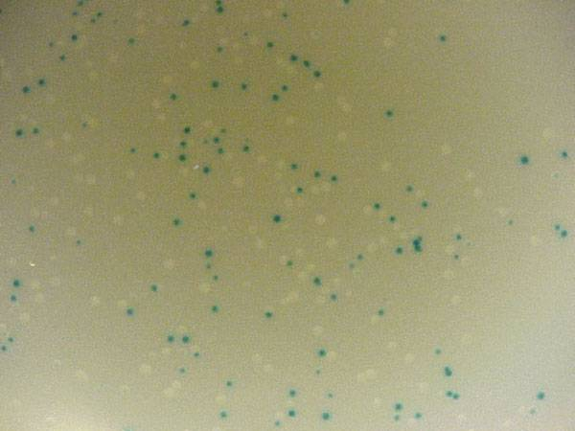
Example of lacZ stained cells
http://www.bio.davidson.edu/courses/genomics/method/reporters.html
Notes:
66
Perhaps the most common use of lacZ is for blue/white selection when cloning a DNA insert into a plasmid (figure 3). If the plasmid contains a version of lacZ with a polylinker, then you can determine visually whether you have cloned the insert or not. If the insert is ligated into the polylinker, then the lacZ gene will be disrupted and the colony will be white. If no insert is incorporated into the plasmid, the lacZ gene is left intact and it is able to produce β-galactosidase and the colon will turn blue. Notice in how some colonies are dark blue, some are light blue and others are pure white. You can tell that this system is not 100% error free. In fact, if the insert is a multiple of three base pairs in size, it might be possible to create an inframe insertion and still produce blue colonies. Nevertheless, blue/white selection is a helpful way to visually screen the success of your ligation and transformation before isolating plasmid DNA.

Slide 67
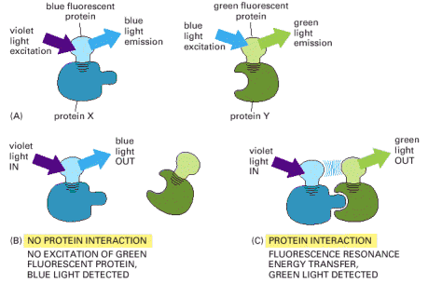
Fluorescence resonance energy transfer: Protein interactions? No worries, just FRET
Often used to measure changes in interactions between proteins or within a protein due to conformational changes
The unbound protein X that has been labeled with fluorescent protein will emit blue photons when excited by violet light using BFP as the fluorophore.
Binding of the protein Y to X changes the conformation and through FRET, changes the emitted light to green using GFP as the fluorophore.
Notes:
67
GFP, and its derivatives of different colors, can also be used to monitor protein-protein interactions. In this application, two proteins of interest are each labeled with a different fluorochrome, such that the emission spectrum of one fluorochrome overlaps the absorption spectrum of the second fluorochrome. If the two proteins—and their attached fluorochromes—come very close to each other (within about 1–10 nm), the energy of the absorbed light will be transferred from one fluorochrome to the other. The energy transfer, called fluorescence resonance energy transfer (FRET), is determined by illuminating the first fluorochrome and measuring emission from the second (Figure 8-49). By using two different spectral variants of GFP as the fluorochromes in such studies, one can monitor the interaction of any two protein molecules inside a living cell.
Figure 8-49. Fluorescence resonance energy transfer (FRET). To determine whether (and when) two proteins interact inside the cell, the proteins are first produced as fusion proteins attached to different variants of GFP. (A) In this example, protein X is coupled to a blue fluorescent protein, which is excited by violet light (370–440 nm) and emits blue light (440–480 nm); protein Y is coupled to a green fluorescent protein, which is excited by blue light and emits green light (510 nm). (B) If protein X and Y do not interact, illuminating the sample with violet light yields fluorescence from the blue fluorescent protein only. (C) When protein X and protein Y interact, FRET can now occur. Illuminating the sample with violet light excites the blue fluorescent protein, whose emission in turn excites the green fluorescent protein, resulting in an emission of green light. The fluorochromes must be quite close together—within about 1–10 nm of one another—for FRET to occur. Because not every molecule of protein X and protein Y is bound at all times, some blue light may still be detected. But as the two proteins begin to interact, emission from the donor GFP falls as the emission from the acceptor GFP rises.
See also http://www.olympusfluoview.com/applications/fretintro.html

Slide 68
Clicker Question
How would you identify a mystery protein if it was in a mix of other proteins and was soluble in water?
Crystallize the protein and use NMR spectroscopy
Use chromatography to separate from proteins of other sizes, then use x-ray diffraction if the molecule can be crystallized (or NMR spectroscopy if it can not)
Use a yeast two-hybrid system to quantify fluorescence resonance energy transfer
Use mass spectroscopy to pass the liquid mixture through a magnetic field that separates fragments by their mass/charge ratio (m/z ratio)
Notes:
68
Answer is B

Slide 69
How would you ID a mystery protein if:
You had a protein crystal
X-ray diffraction
You had to extract it from a mix of proteins
Chromatography
It had to be in solution
NMR spectroscopy
You wanted to find proteins that interacted with a specific protein of interest
Yeast two-hybrid system
FRET
Notes:
69

Slide 70
Summary
Protein interactions are specific
Protein identification
Chromatography
Mass spectroscopy
Gel electrophoresis
X-ray diffraction
Electron microscopy
Protein function
Yeast two hybrid system
Fluorescence energy transfer

Slide 71

Protein folding can also be monitored using FRET
Gershenson et al. 2011
Notes:
Monitoring protein folding kinetics in a living cell using fast relaxation imaging (FReI) [68]. (a) The folding sensor was created by sandwiching a
temperature-sensitive POI (here, PGK) between two fluorescent proteins, GFP and mCherry, allowing folding to be monitored by FRET. (b) Image of
the fluorescence arising from the expression of the fusion protein in a human cell. (c) Map of the refolding dynamics of the fusion protein in the cell
shown in (b). The time dependence of the FRET signal following a temperature jump is spatially mapped. (b) and (c) are courtesy of M. Gruebele.

Slide 72
D and E show the TRPV1 channel ( a pain receptor) at high resolution in cryo-EM (D) and fully reconstructed (E)
Notes:
Figure 3. Direct Electron Detection Camera Enabled Major Breakthroughs in Single Particle Cryo-EM(A) An image of frozen hydrated T. acidophilum 20S proteasome recorded using K2 Summit camera with a 300-kV microscope and a defocus of 0.9 mm.(B) Fourier transform of a typical imperfect image of frozen hydrated 20S proteasome, showing a predominant resolution cutoff caused by beam-induced motion.(C) Fourier transform of the same image after motion correction. Thon ring is restored to reso-lution of 3A˚ .(D) 2D class averages of TRPV1 ion channel calculated from images recorded with a scintillator camera (left) and K2 Summit camera (right) (Liao et al., 2013).(E) Two different views of TRPV1 3D reconstruc-tion determined from a dataset collected with a scintillator camera.(F) Same views of the TRPV1 3D reconstruction determined from a dataset collected with a K2 Summit camera. (A–C) are reproduced from (Li et al., 2013).

